Slide 1

ROAD ACCIDENT ANALYSIS
Understanding Trends, Causes, and Prevention

Slide 2

Introduction to Road Accident Analysis:
Road accident analysis involves the systematic study of traffic accidents to understand their causes, trends, and implications. It helps in identifying risk factors, evaluating road safety measures, and formulating strategies for prevention.

Slide 3

Importance of Road Accident Analysis:
Analysis of accident data provides valuable insights for policymakers, law enforcement agencies, and urban planners to make informed decisions regarding road safety initiatives.

Slide 4
Factors Influencing Road Accidents:
1. Human Factors: Including driver behavior, impairment (e.g., alcohol, drugs), and distraction.
2. Vehicle Factors: Such as mechanical failures, design flaws, and safety features.
3. Road Environment: Including road design, signage, lighting, and weather conditions.

Slide 5
How data is been collected for analysis:
For this project we have use the method of secondary analysis, which is getting data from internet.
We found our ideal dataset from google drive which is available on google

Slide 6
Determining Requirements:
If total casualties and total accidents of current year and if it is increasing Year on Year.
Total casualties by accident severity for current year and year growth.
Total casualties with respect to vehicle type for current year.
Monthly trend showing comparison of casualties for CY and PY.
Casualties by road type CY.
CY casualties by location and day/night.
Total Casualties and Total Accident by location.

Slide 7

Analysing features of dataset:
In this we review
What feature is needed for our visualization and what is not.
To know if there are any missing value, incorrect value etc.

Slide 8

How data cleaning and modelling is done :
We used Power BI for same : i.e. Load and Transformation is done in same

Slide 9

Methods of Analysis:
1. Descriptive Analysis: Examining the characteristics of accidents, such as location, time, and severity.
1
2. Statistical Analysis: Identifying trends, patterns, and correlations in accident data.
2
3. Spatial Analysis: Using geographic information systems (GIS) to map accident locations and identify hotspots.
3

Slide 10
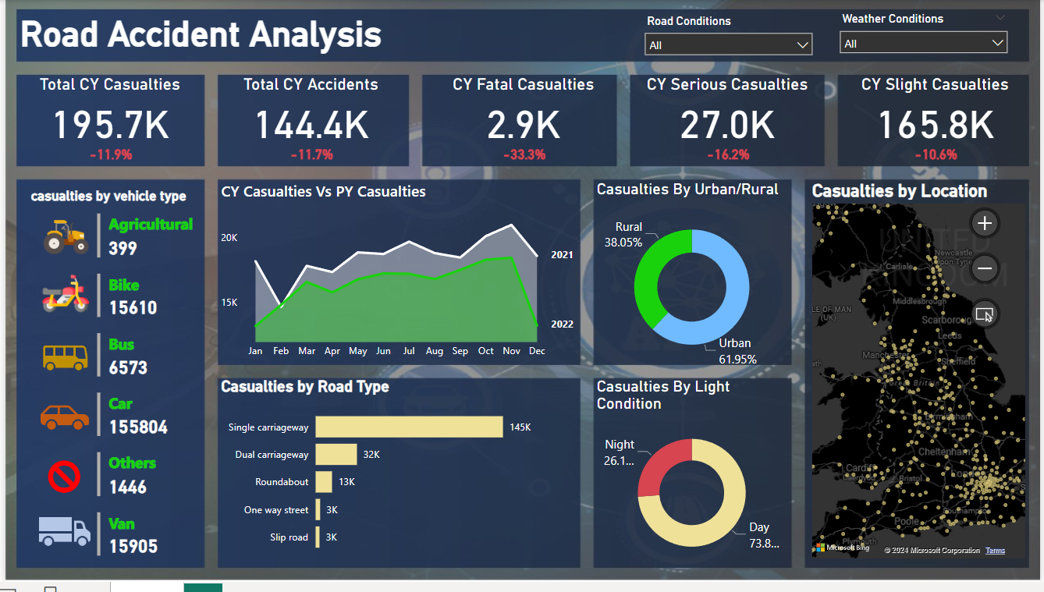

Slide 11

Conclusion:
Road accident analysis plays a crucial role in improving road safety and reducing the number of casualties. By understanding the underlying causes and implementing effective preventive measures, we can create safer road environments for everyone.

